Slide 1
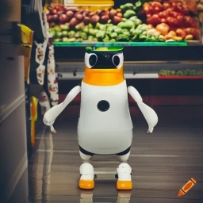
ECE4078 Intelligent robotics
AI art generated by https://www.craiyon.com/
(prompt: “a penguin robot shopping for fruits and vegetables in a supermarket”)
Lab 1: Setup and Teleoperation

Slide 2
ECE4078 Intelligent robotics
The aim of the project is to develop a grocery shopping robot.
You will be required to search, identify, locate and “pick-up” target fruits and vegs on a shopping list using a PenguinPi robot in a 3m*3m “supermarket” (arena).
Within the “supermarket” there will be 10 “aisle labels” (ARUCO markers) to help the robot locate itself and the targets.
Each of the labs will focus on a subsection of the task, i.e., the lab milestones.

Slide 3
ECE4078 Intelligent robotics
5 milestones + a final demo: live demo marking on physical robot
Submission deadline is right before the start of the due lab session
Week | Objectives | Milestones
2: M1-1 | Introduction and setup
3: M2-1 | Calibration, ARUCO markers | M1 due
4: M2-2 | SLAM
5: M2-3 | SLAM
6: M3-1 | Object recognition & localisation | M2 due
7: M3-2 | Object recognition & localisation
8: M4-1 | Navigation & Planning | M3 due
9: M4-2 | Navigation & Planning
10: M5 | Integration & Improvement | M4 due
11: Final | Trial run of final demo | M5 due
12: Final | Final demo | Final demo
*
Submit code
before your lab
session

Slide 4
ECE4078 Intelligent robotics
Each of the milestones accounts for 4% of your unit grade (total of 20%). The final demo will account for 60% of your unit grade (no final exam).
You’ll work in teams of 3 (except for M1): ITP team formation and surveys
During a marking session, each group will present their submission to the demonstrators.
Further instructions on Moodle and Github repo
Slack is the main communication channel

Slide 5
This week’s lab
1: Installing the environment
Instructions can be found on GitHub under “Week01-02” folder – “InstallationGuidePhysical.md”
Simulator env (see “Robot_simulator” folder) not required but may be helpful
If you only plan to work with the physical robot, then only the python packages are required (skip the steps on setting up the Ubuntu 18 ROS environment)
2: Implement teleoperation
Skeleton code is provided: “operate.py” but not compulsory to use
M1 total 100 points (marked as individuals): - Drive forward (25pts)
- Drive backwards (25pts)
- Turn left (25pts)
- Turn right (25pts)
3: You may ask to be marked during this week’s lab if you finish early (submit your code on Moodle first following the marking steps)

Slide 6
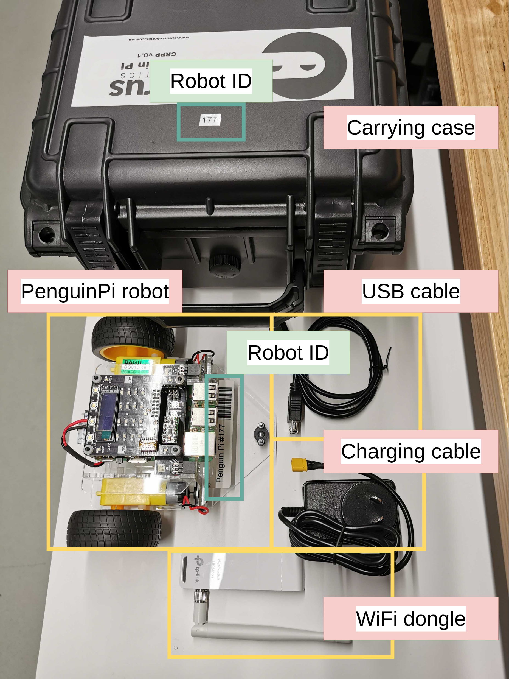
Inside the robot kit
(from next week each group can bring a robot home)

Slide 7
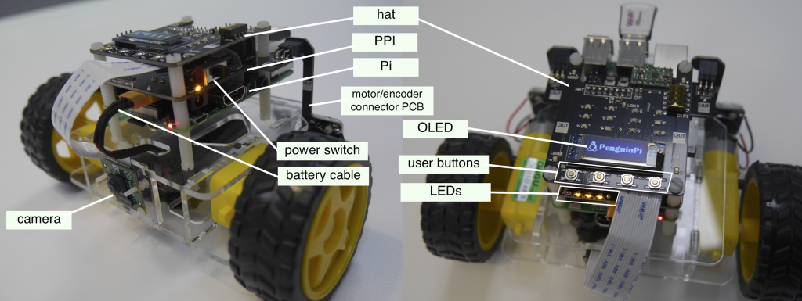
The PenguinPi robot: see “InstallationGuidePhysical.md”

Slide 8
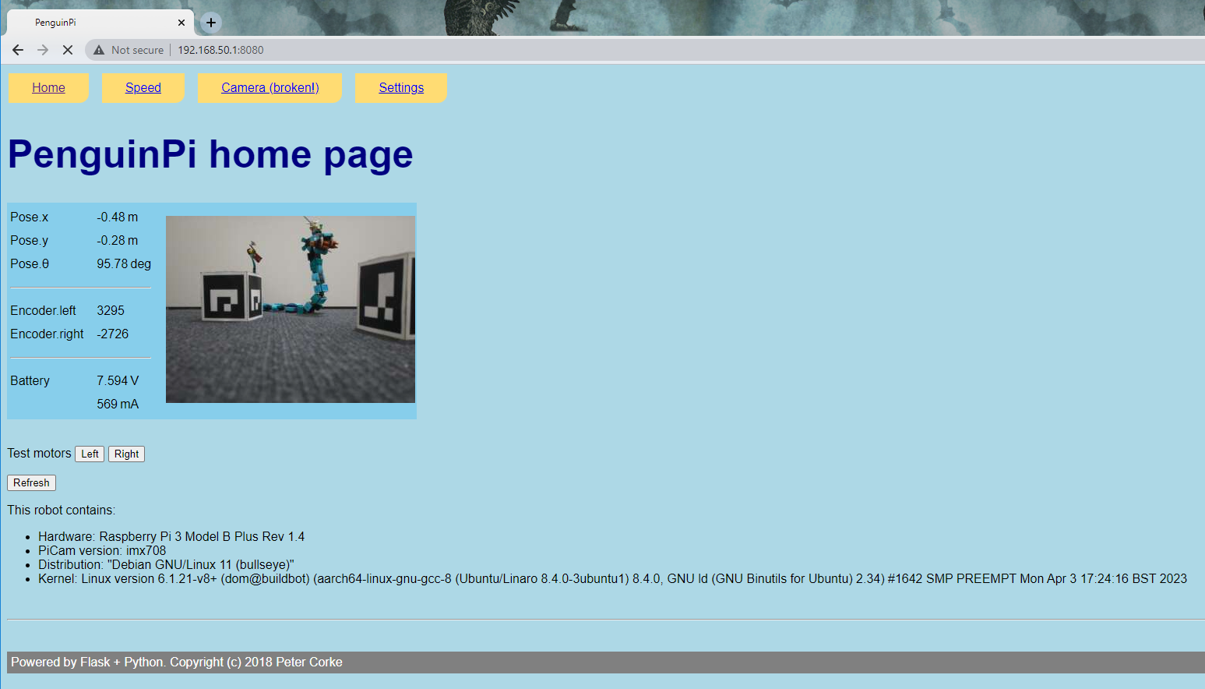
Connect to robot: let us know if anything is broken

Slide 9
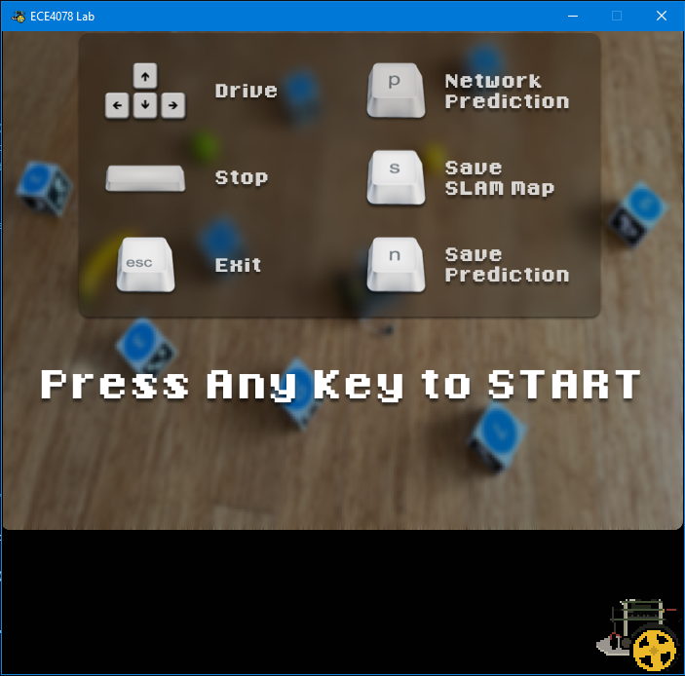
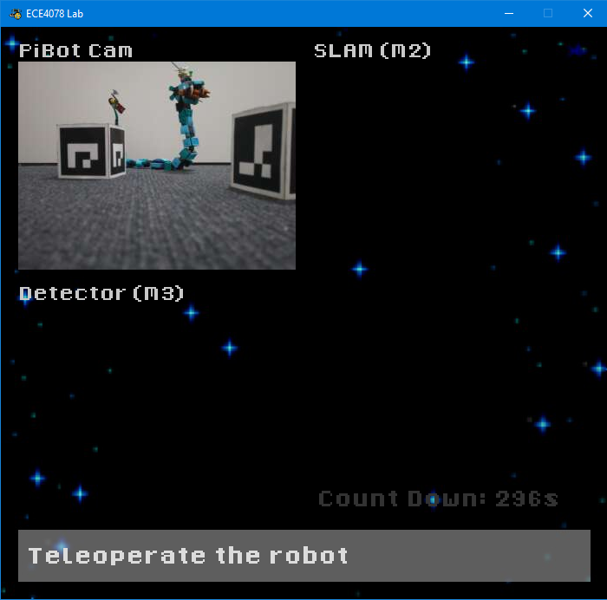
Running teleoperation

Slide 10



Additional recommendations (optional)
- Install a python IDE (pick one)
PyCharm
Spyder
Visual studio code
Or anything else familiar to you
- Extension to basic teleoperation functions:
Implement variable speed control
Implement arc turning & on spot turning
Turn off sticky keys (robots stops when not holding a button)
Implement time normalisation (Perform an iteration every N milliseconds compared to as fast as possible)

